Slide 1

Customer Segmentation & Insights
2nd Assignment on Business Intelligence

Slide 2

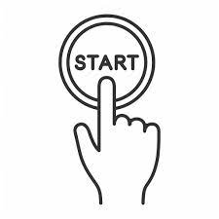


Visualization
&
Insights
ETL
Process
Customer Analysis
2nd Assignment on Business Intelligence

Slide 3
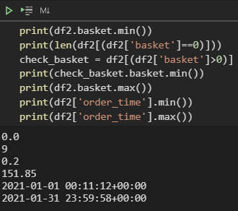
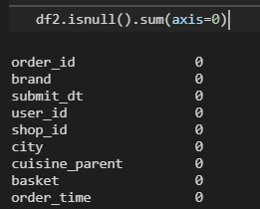
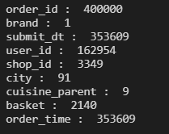
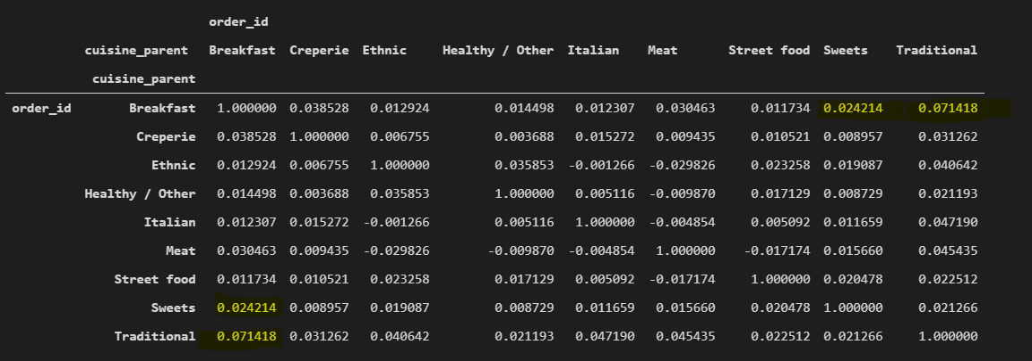
ETL Process
Extract dataset table from Big Query at json format to keep the Greek names in city column.
Import the data in python with the correct format (fixing the date format)
Perform some initial checks:
Check the key (Combination of columns with distinct values)
Check the count of null values per columns
Check initial descriptive statistics per columns
Count
Sum, mean for numerical columns (e.g ‘basket’)
Distinct number (e.g cities, cuisines, users)
Check correlation across cuisine-parents for all users using the count of orders and the total basket amount.
No significant linear relationship foun
Python Code used for executing the commands on Visual Studio Code is located at this link
Initial Checks
Distinct Count
Correlation Matrix
2nd Assignment on Business Intelligence

Slide 4
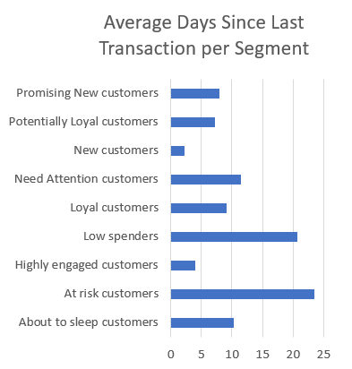
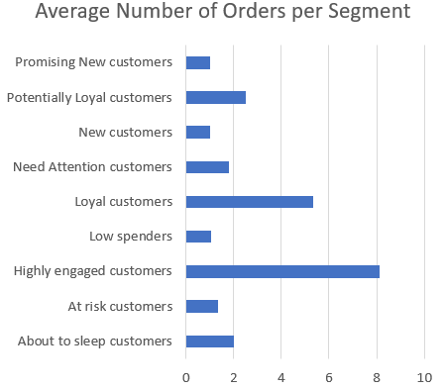
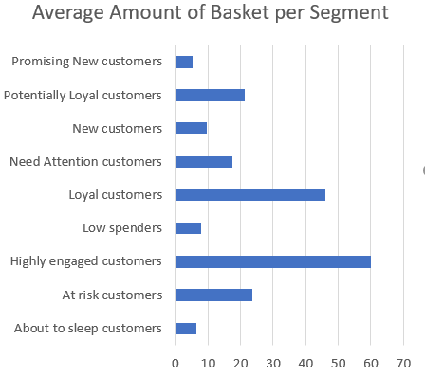
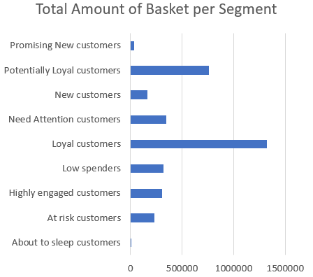
Customer Segmentation
Methodology 1:
RFM (recency, frequency, monetary) analysis is a behavior - based technique used to segment customers by examining their transaction history such as:
How recently a customer has purchased (recency)
How often they purchase (frequency)
How much the customer spends (monetary)
Assumption:
We are performing analysis at 1rst of February. So, If a user has made one transaction the recency will be calculated as:
(01/02/2021 – transaction date)
Segments Creation
Based on specific Rules, users were split into segments.

Slide 5
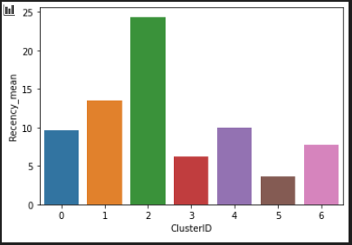
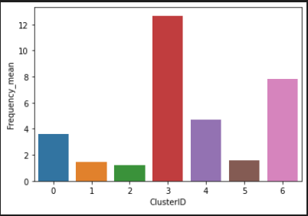
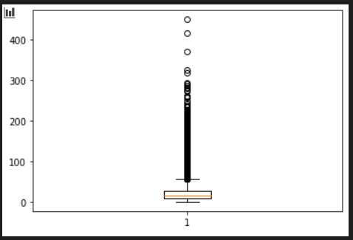
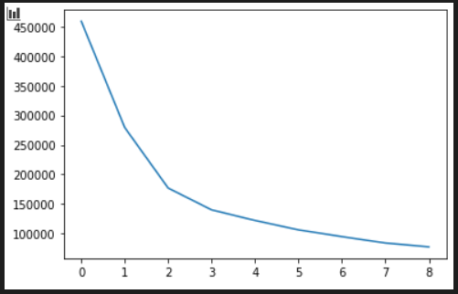
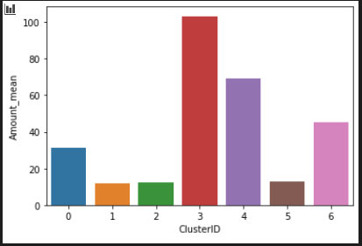
Customer Segmentation
Methodology 2:
K - Means clustering based on RFM KPIs.
After creating the KPIs (recency, frequency, monetary), each metric was checked for outliers. The final decision was to keep outliers to identify users with extreme activity.
Decision:
First thought was to split the dataset into 4 segments (0,1,2,3). But checking the average value per segment for each KPI, I decided to increase the number of segments in order not to lose any group.
Finally, the number of segments selected was 7 (0,1,2,3,4,5,6).
Segment 0:
Low Spenders
Segment 1:
About to sleep Customers
Segment 2:
At Risk Customers
Segment 3:
Loyal Customers
Segment 4:
Potentially Loyal Customers – Need attention
Segment 5:
Highly engaged but low-spent Customers
Segment 6:
Potentially Loyal Customers

Slide 6
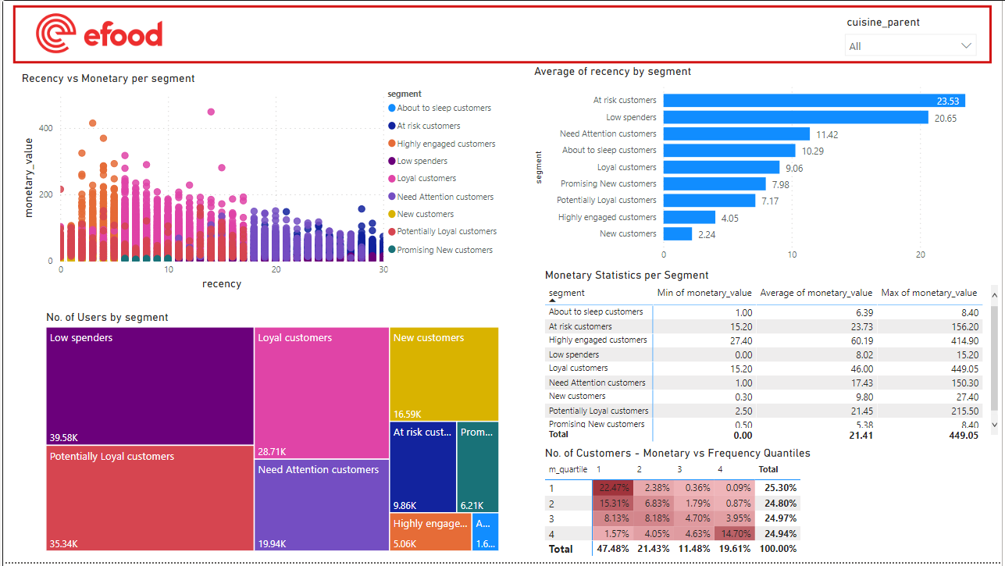
Visualization
Methodology 1:

Slide 7
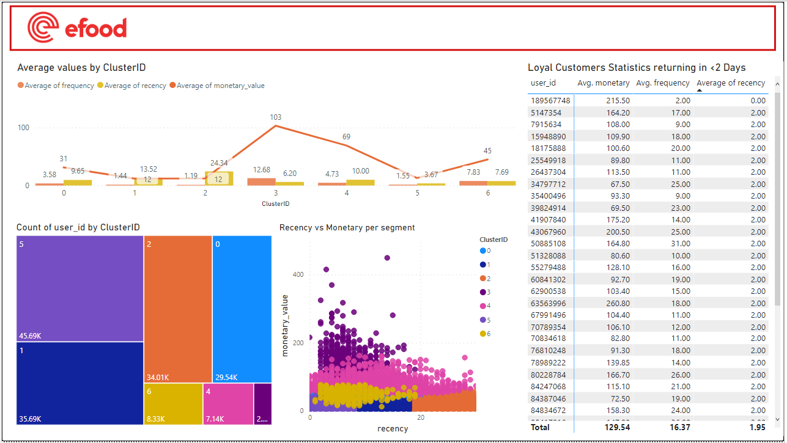
Visualization
Methodology 2:

Slide 8
Discussion
Question:
Which segment could be a valuable target group for a Marketing campaign about Coffee (“Breakfast” cuisine_parent)?
Performing an extra analysis in PBI for Breakfast category:
The second most valuable group apart from Loyal Customers is the “Potentially Loyal customers” having half the amount of basket compared to the Loyal Customers. They buy as frequent as Loyal Customers with slightly less orders.
However, the question can be answered only when we know what is the goal.
If the goal is to target the existing loyal customer, then we should follow a reward marketing promotion strategy
If the goal is to target the “Need Attention” customers, then we should follow a different marketing promotion strategy, giving a coupon or some extra credits in a promo card.

